Slide 1
Galeazzi Fractures
Nyakure

Slide 19
Definition
distal 1/3 radius shaft fx AND
associated distal radioulnar joint (DRUJ) injury

Slide 20
Epidemiology
Incidence of DRUJ instability
if radial fracture is <7.5 cm from articular surface
unstable in 55%
if radial fracture is >7.5 cm from articular surface
unstable in 6%
Mechanism
direct wrist trauma
typically dorsolateral aspect
fall onto outstretched hand with forearm in pronation

Slide 21
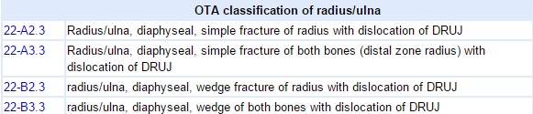
Classifications

Slide 22
Clinical presentation
Symptoms
pain, swelling, deformity
Physical exam
point tenderness over fracture site
ROM
test forearm supination and pronation for instability
DRUJ stress
causes wrist or midline forearm pain

Slide 23
Imaging
Radiographs
recommended views
AP and lateral views of forearm, elbow, and wrist
findings
signs of DRUJ injury
ulnar styloid fx
widening of joint on AP view
dorsal or volar displacement on lateral view
radial shortening (≥5mm)

Slide 24
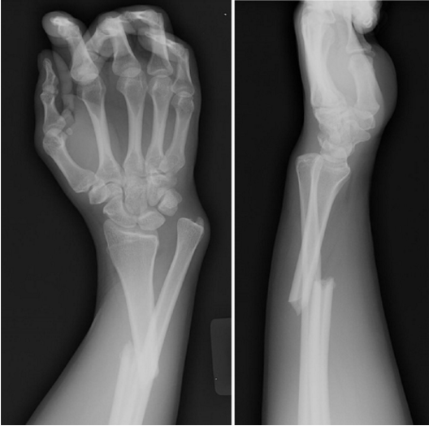
Image

Slide 25
Operative treatment
ORIF of radius with reduction and stabilization of DRUJ
indications
all cases, as anatomic reduction of DRUJ is required
acute operative treatment far superior to late reconstruction

Slide 26
Complications
Compartment syndrome: high energy crush injury, open fractures, vascular injuries or coagulopathies
Neurovascular injury
Refracture: removing plate too early (minimum 18 months), large plates (4.5mm), comminuted fractures, persistent radiographic lucency
Nonunion
Malunion
DRUJ subluxation

